Slide 1

Memory Management
Abhishek (Abi) Parekh
Faculty of Engineering and Computer Science
Syracuse University
December 7th, 2022
Professor:
Dr. Mo Abdallah

Slide 2
Topic & Problem
REDUCING IMPROPER MEMORY USAGES IN THE INTEREST OF EFFICIENTLY MANAGING MEMORY
Professor:
Dr. Mo Abdallah

Slide 3
Objective
Explore the topic of memory management
How to efficiently maintain memory space for processes & programs
Techniques to reduce unused memory blocks
Properly utilize main memory to minimize fragmentation issues

Slide 4
SUMMARIES

Slide 5
Managing memory in the OS
Loading types
Static Loading - loads the entire program into a fixed address
Dynamic Loading - waits for the process to be called and then fetches the data
Swapping
briefly moving a process from the main memory into secondary memory
Internal Fragmentation
occurs when much more memory is allocated than requested, leading to unused space
External Fragmentation
there is a free memory block, however a process cannot be allocated to that block since free memory cannot be contiguous

Slide 6
Storage Reclamation
Reclamation of unused memory blocks is done automatically using a runtime process called garbage-collection
C, C++ , LISP & Prolog are not capable of this
Incremental - combines the collecting task with the actual computation, adds any unused blocks
Wait - Let all free memory blocks get used, then reclaim all useless cells
A perfect reclamation - all useless blocks reclaimed & none in use cells are damaged

Slide 7
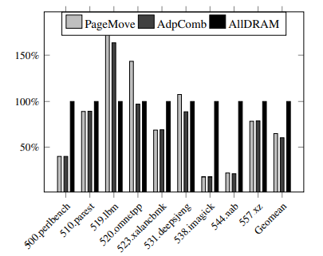
Hybrid Memory Systems - for mobile devices
Frequent data swaps between memory and storage caused by insufficient DRAM main memory impacted
performance
higher energy used
reduced write endurance of standard flash storage systems
An integration of different types of memory & design structure leads to robust memory usages.
AllDRAM cuts energy usages by 40%
loses performance by 12%

Slide 8
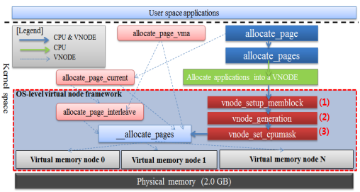
Virtual Memory Node - for mobile devices
Memory dies out when less memory is accessible for frequent usages.
VNODE has three components
vnode
setup
memblock
gains the strength of complete memory isolation
reduces the number of LMK/OOMK
Prevents fragmentation & thrashing
VNODE Diagram

Slide 9
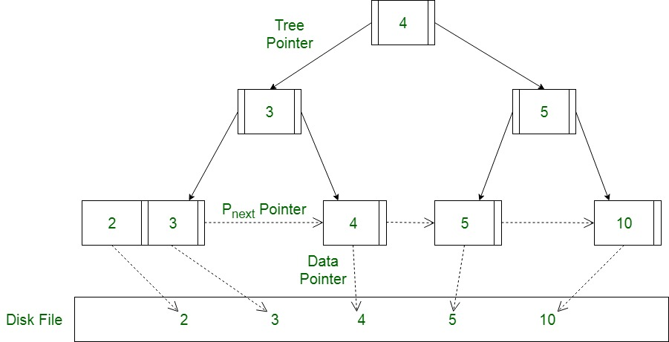
Non Volatile Main Memory
To maintain consistency
protect against memory damage
avoiding erroneous writes
NVRAM must be directly connected to the memory bus
Benefits
high-performance
data remains secure
Reduced thrashing
B+ Tree

Slide 10
Dynamic Memory Management
Mainly used to gain faster load times & dynamically manage storage
Made for heavy applications
Garbage collection
example of dynamic memory management
automatically reclaim unnecessary memory blocks
When dynamic memory is not used:
A bigger block size leads to higher internal fragmentation, leading to worst fit
causes fragmentation to occur

Slide 11
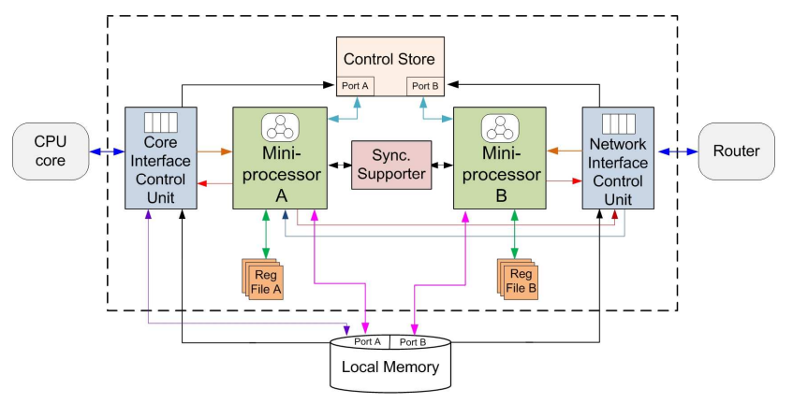
Network-on-chip Architecture
Suggests that a Data Management Engine with a robust architecture can dynamically handle allocation and deallocation.
Architecture includes:
Core interface
network interface
mini processors
control store
synchronization supporter
Dynamic uploading of data into the control store
NoC Architecture

Slide 12
Memory Management in Real Time Devices
It creates a new memory partition with a certain block size
Then it allocates that block, and releases it
Any unused space and used space is displayed
updates every time a block is allocated
Lots of free memory causes quicker search times
therefore it is important to reclaim any unused cells
In this study, allocator rounds up the requested block size & allows the user to choose a larger block from another unoccupied list

Slide 13
Multi-Layer Memory Resiliency
Protection against memory degradation and failure
Hardware & software usage to develop multi-layer memory protection
Dynamic approach is used to achieve energy savings in the cache
also helps in deleting erroneous blocks of memory
Aims to reduce the aging of memory blocks on layers of memory
Ensures that if a blocks loses data, the mechanism would have exported that data into another layer of memory, for sole purpose of preserving it for longer time

Slide 14
PROPOSED SOLUTION

Slide 15
Real Time Memory management
Architecture
Create a Dynamic memory system that handles real time data in a storage control and fetches it from the local memory
Multiple processors & in interfaces
to quickly allocate and deallocate memory blocks
Reclaiming unused memory blocks, maintains quick memory speeds
Benefits
Long lasting high level performance
Omits sluggish response times
Faster load time
Avoids having any fragmentation or thrashing issues
important since device is portable, with minimum memory

Slide 16
THANK YOU!

